Slide 1
NBA Stats Project
Weekly Deliverables
Peyton Ashley VM 31812
UMBC IS296
Spring 2026
Notes:
Project Diary
During the week, work on the tasks as it fits into your schedule
Suggest using pomodoro timer (25 min, 5 min break)
At the end of each day you work on the project, complete this short reflection.
Motivational Surveys Week 2, 4 and 6 - Motivation survey (< 5 min)
Self-efficacy
Intrinsic or extrinsic motivation or lack of motivation
goal structure

Slide 2
Introduction
My presentation is about trends within NBA playoff stats from the 2021 - 2022 season. I will analyze the correlations between stats, like how does a players position affect their performance, and how some stats have correlations or relationships to game outcomes. This will hopefully help the casual NBA player to understand their players' stats and what those stats mean on a higher level. This will hopefully expand their knowledge and love for the sport.

Slide 3
Mini Update #1 - Data Profile for 2021-2022 NBA Playoff Stats
Here is the link to my data profile including all columns needed.
Link
Notes:
Finalize team and topic by Monday
Setup (in class)
Create a team folder (folder name [teamID]_[topic]) in project folder
On Jupyterhub (do not use Google Colab)
Create a folder called “project”
Download data from the given link and upload data into this folder
Mini update 1 (data profiling and curious questions) - see next a few slides
Data profile
Initial set of curious questions, audience and communication goals

Slide 4
Mini Update #1 - Audience and Goals for NBA Stats
Audience: Who is your intended audience for the data stories to be created?
The intended audience is NBA fans
Goals: What is your communication goal?
The goal is to allow fans to have a deeper understanding of the sport by understanding how their favorite players perform in relation to other players
Notes:
For the first week, please create 1-2 slides answering the following questions pertaining to your project
(1) Curious Questions: A list of burning and curious questions your project is interested in exploring. This could be based on background reading or some initial understanding of the dataset, or simply driven by your curiosity. You don't have to start exploring the dataset yet in order to come up with those questions. You will refine those questions later on. I will not hold you accountable for answering those questions within the scope of the project, you might notice that some questions cannot be answered given the limitation of the data, the limitation of your skillset, or the limitation of time. This exercise will give you an opportunity to develop "visionary thinking" as a strategic planning process - so feel free to be bold and ambitious
(2) Audience: who is your intended audience for the data stories to be created?
(3) Communication Goal: what is your communication goal? e.g. to change behavior, to change mindset, to change heart, to change perspective, to improve understanding, to induce action?

Slide 5
Mini Update #1 - Curious Questions
Do minutes played lead to more points, assists, and rebounds?
Does more 3 point attempts lead to lower or higher feild goal%?
How do points, assists, rebounds, steals differ by position?
Does less points lead to more assists?
What players have statistical outliers?
Does better defensive stats lead to worse offensive stats?
Are players who score more points more efficient?
Notes:
For the first week, please create 1-2 slides answering the following questions pertaining to your project
(1) Curious Questions: A list of burning and curious questions your project is interested in exploring. This could be based on background reading or some initial understanding of the dataset, or simply driven by your curiosity. You don't have to start exploring the dataset yet in order to come up with those questions. You will refine those questions later on. I will not hold you accountable for answering those questions within the scope of the project, you might notice that some questions cannot be answered given the limitation of the data, the limitation of your skillset, or the limitation of time. This exercise will give you an opportunity to develop "visionary thinking" as a strategic planning process - so feel free to be bold and ambitious
(2) Audience: who is your intended audience for the data stories to be created?
(3) Communication Goal: what is your communication goal? e.g. to change behavior, to change mindset, to change heart, to change perspective, to improve understanding, to induce action?

Slide 6
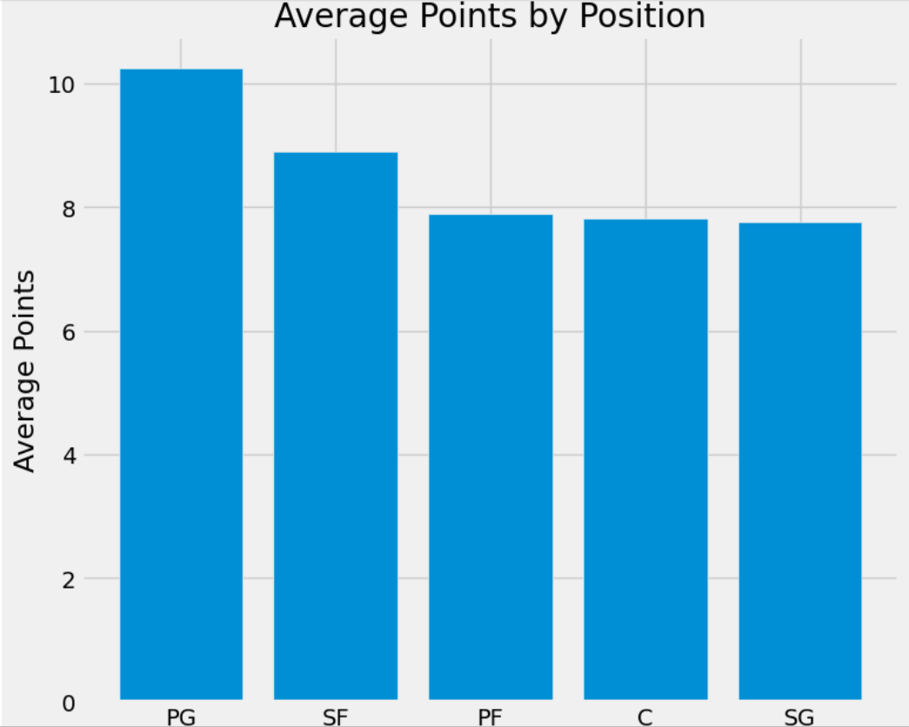
Mini Update 2 - Data Insight 1 - Average Points by Player Position
This graph shows the ranking of the average number of points scored by NBA players, by their position on the court. We can see that the 2 positions that score noticeably more than others are point guards and small forwards. One could conclude from this that the teams that score the most points have the best point guards and small forwards.
Notes:
Contents A few slides on Data Insights
One data insight per slide
Plots/tables + narrative (remember include both show and tell)
Please do not include codes
Aim for 2-3 data insights slide/member/week (please mark contributor on each data insight slide)
One slide on progress
What has accomplished and what is the plan for next week
What are the obstacles that you need help
What kind of resources you have used
Contribution of each team member (for group)
One slide on feedback (if you received any from previous week)
tell us something about (1) the feedback you received;(2) if and how you address the feedback; (3) whether you feel the feedback is useful; (4) what additional feedback you are seeking

Slide 7
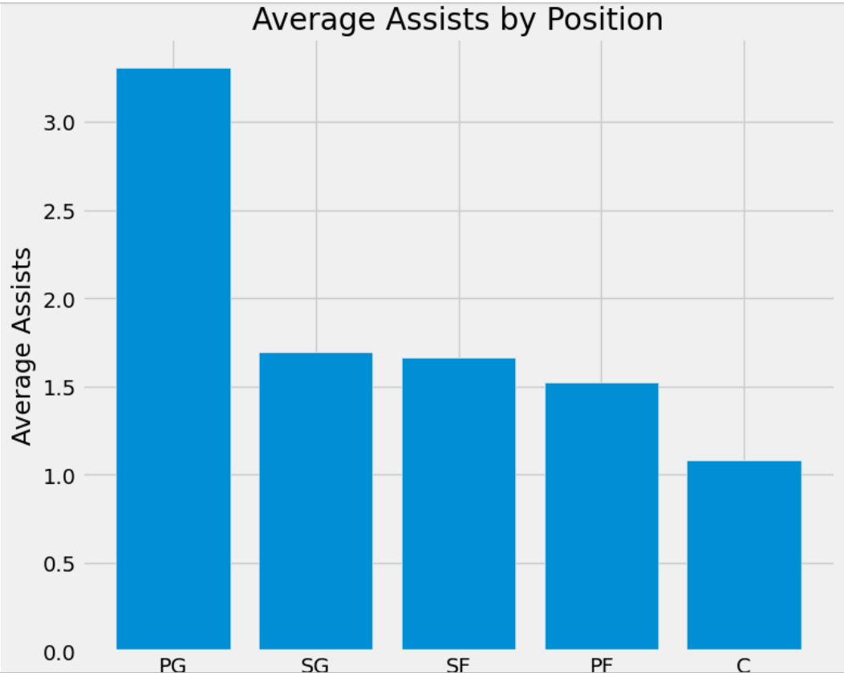
Mini Update 2 - Data Insight 2 - Average Assists by Player Position
This graph shows the number of assists the average NBA player records, broken down by their on-court position. We can see that point guards earn noticeably more assists than other positions, while centers are clearly below the others in assists. One could conclude from this that, on most teams, the point guard is primarily responsible for helping others score, while the center is not relied upon as heavily for this facet of the game.

Slide 8
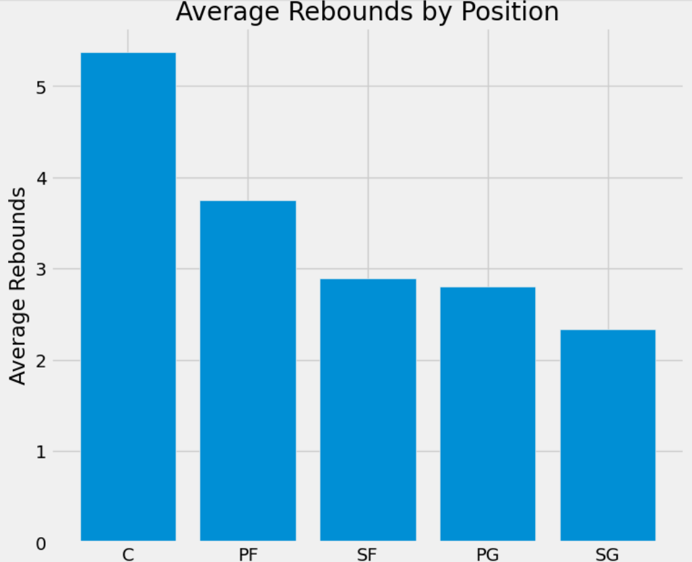
Mini Update 2 - Data Insight 3 - Average Rebounds by Position
Show Table
This graph shows the number of rebounds the average NBA player records, broken down by their on-court position. We can see that the positions that get noticeably more rebounds than others are centers and power forwards. From this, one could conclude that on most teams the center and power forward are relied upon for their dominance on the glass, securing both offensive and defensive rebounds.

Slide 9
Mini Update #2 - Progress
What have you accomplished?
I completed the Mini update #2 insights, as well as coded graphs for them.
What is the plan for next week?
Complete the Mini updates for this week as well as the graphs.
What are the obstacles that you need help?
I first struggled importing the data into Jupyter
What kind of resources you have used?
Jupyter
My work from Lab #4
Previous weeks slides

Slide 10
Mini Update #2 - Feedback
I have not received any feedback because I completed this late. Any feedback you can provide would be appreciated.

Slide 11
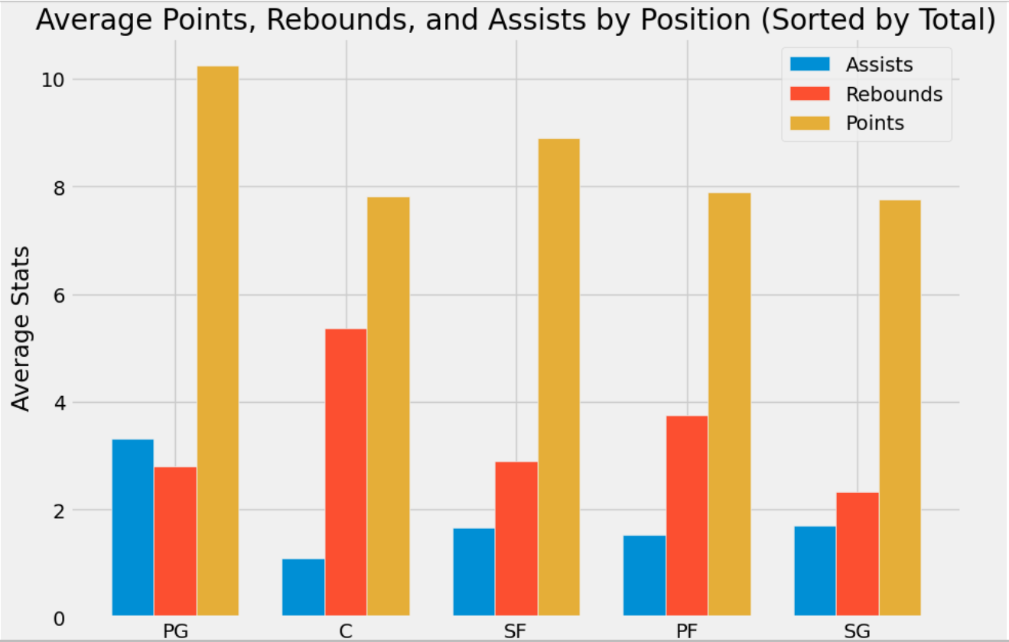
Mini Update 3 - Data Insight 1
Average Points, Rebounds and Assists by Player Position
This graph shows the ranking of positions based on the total of their stats from points, assists, and rebounds. We can see that the positions that get noticeably more stats than others are point guards and centers, with the most points and rebounds, respectively, while also performing well in other categories. The position that lacks the most is shooting guard, who has the fewest points and rebounds, and is in the bottom half for assists. One could draw the conclusion that, from a purely statistical perspective, shooting guards provide the least value to their team.

Slide 12
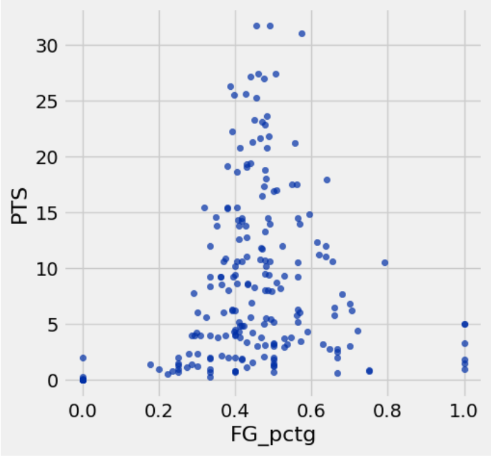
Mini Update 3 - Data Insight 2 - Points vs. Field Goal %
This data shows the correlation between average points scored per game and field goal percentage. We can see that the points per game peak at 45% FG% from the field. This is an interesting fact, given that the logical assumption would be that the players with the highest efficiency would score the most points. We can see from the data that this is untrue. The likely reason is that the better a player is, the opposing team is more likely to put their best defender making it harder for them to score.

Slide 13
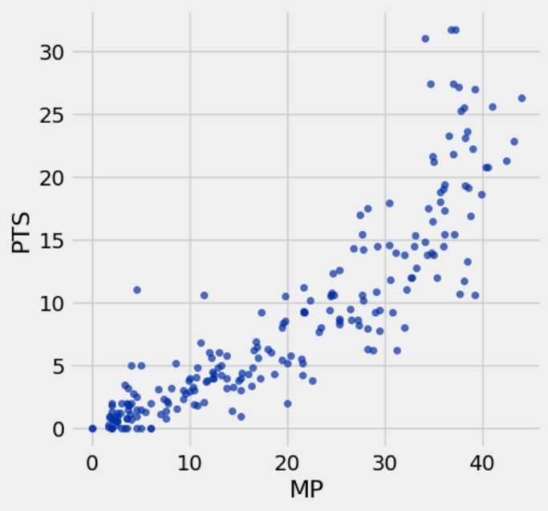
Mini Update 3 - Data Insight 3 - Relation of minutes played to points per game
This graph shows the relation between minutes played and points scored per game. As you can see, the graph shows an exponential growth function, which means as minutes go up, points scored goes up by a greater and greater rate. This can be explained by noting that the player who scores the most points tends to get the most playing time, leading to more points scored.

Slide 14
Mini Update #3 - Progress
What has accomplished
I completed the Mini update #3 insights, as well as coded graphs for them.
what is the plan for next week
Complete the Mini updates for that week as well as the graphs.
What are the obstacles that you need help
Figuring out how to do the data for the bar graph
What kind of resources you have used
Jupyter
My work from Lab #4
Previous weeks slides

Slide 15
Mini Update #3 - Feedback
I have not received any feedback because I did this late, but I’d appreciate any feedback you can provide.

Slide 16
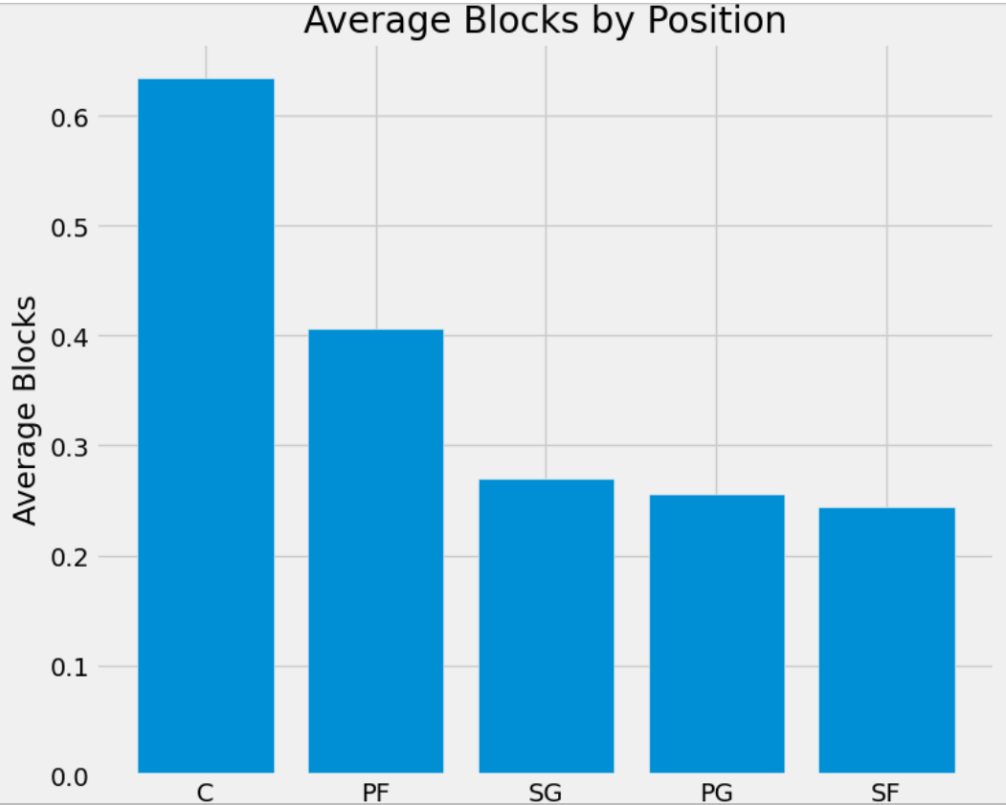
Mini Update 4 - Data Insight 1 Average Blocks by Player Position
This graph shows the number of Blocks the average NBA player records, broken down by their on-court position. We can see that the positions that get noticeably more blocksthan others are centers and power forwards.This could be related to them being generally taller and therefore are going to have an easier time of intercepting the ball midair and getting a block.

Slide 17
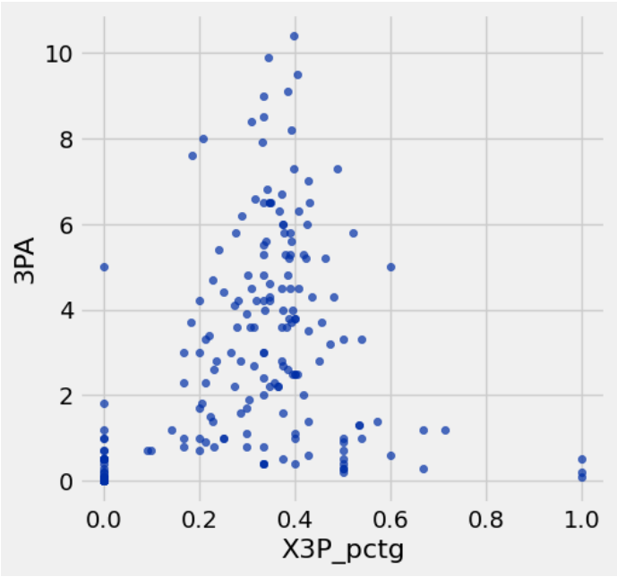
Mini Update 4 - Data Insight 2
3 Point attempts by 3pt percentage
This graph shows the relation between 3 Point attempts by a players 3 PT percentage. As you can see, the graph shows that the players who take the most 3 point attempts do not have the highest make percentage, but instead tend to gravitate toward the 40% range. This is most likely because of the in consistency of those who have a higher percentage of shots made. If a player only shoots once and makes it then they will have a 100% make rate, yet they are not trusted to shoot as many as those who can be trusted to shoot 6+ at a 40% rate.

Slide 18
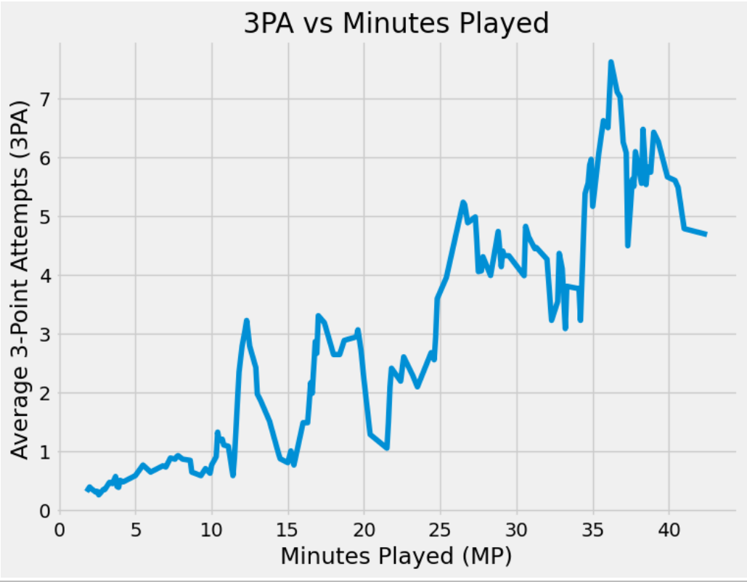
Mini Update 4 - Data Insight 3
3PA by minutes played
This graph shows the relation between minutes played and 3 pointers attempted. As you can see, the graph shows a general linear slope with a sharp down take for the player who play 37 minutes plus. In general we can draw the conclusion taht most player simply shoot more 3 pointers the long that they play. I had suspected that the player who get more playing time may shoot more 3 pointers per minute that those who get kess, but this apprears untrue.

Slide 19
Mini Update #4 - Progress
What has accomplished
I completed the Mini update #4 insights, as well as coded graphs for them.
what is the plan for next week
Complete the Mini updates for that week as well as the graphs.
What are the obstacles that you need help
Figuring out how to do the data for the bar graph and line graphs. Making new connection for the 3 point attempts by minutes played graph
What kind of resources you have used
Jupyter
My work from Lab #4
Previous weeks slides

Slide 20
Mini Update #4 - Feedback

Slide 21
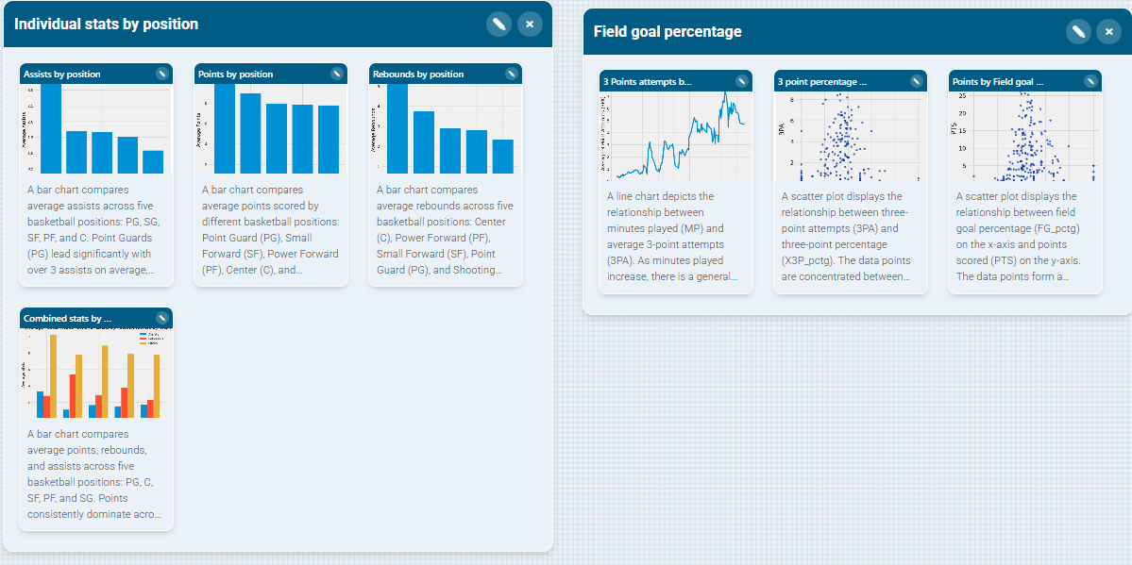
Mini Update 5
These two groups are the two main groups for the data graphs. The first group is the collection of graphs that show stats by position. Three of them shows individual stats by position. One shows points by position. The other two are rebounds and assists. The final shows the combined stats by position. This shows the total combined numbers for each of the previous graphs. The second group is the combination of all the graphs in which we can see a players percentage of mad shots. These 3 together show trends in how eefiecent a player is and how it relates to things like minutes played and shots put up.

Slide 22
Mini Update #5 - Progress

